Slide 1

Game Design with HTML5
Presenter: Shameka Charley, Software Development Instructor, PSM, M.A.Ed

Slide 2

Overview: Game Design with HTML5
Game Design with HTML 5 involves using a combination of the
HTML 5: Structure and Content
CSS 3: Styling
JavaScript: Interactive and Dynamic Games

Slide 3
Basic Concepts: The Trio
HTML5 Canvas:
The <canvas> element is used to draw graphics using scripting (JavaScript)
Rendering game graphic.

Slide 4
Basic Concepts: The Trio: CSS3
CSS3: used for styling the game elements

Slide 5
Basics Concepts: The Trio: JavaScript
JavaScript: Backbone HTML 5
Handles game logic, user input, and interaction with the HTML 5 Canvas

Slide 6
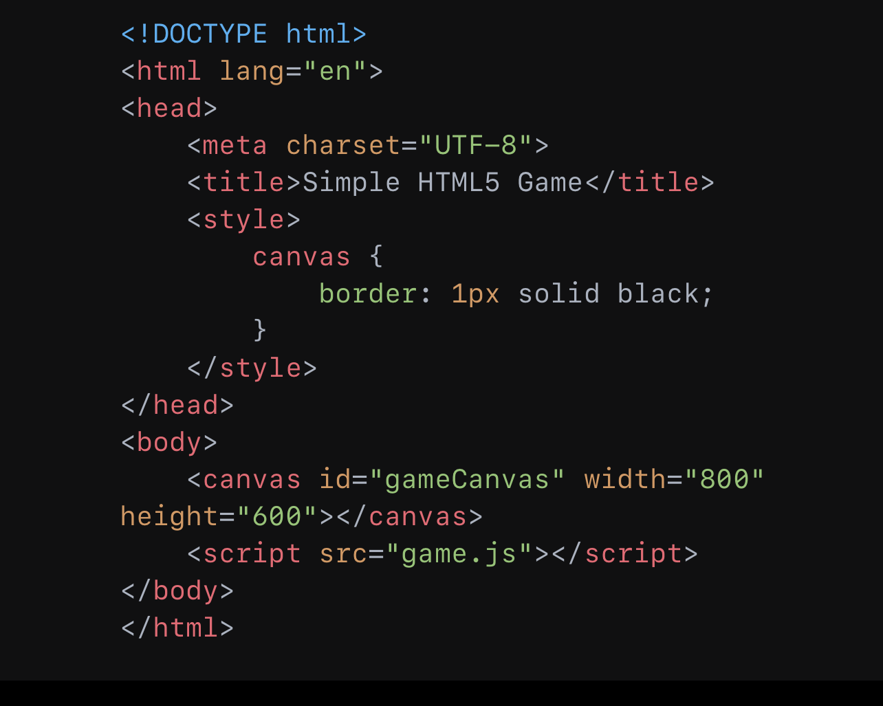
Steps to Create a Simple Game
Setup HTML Structure

Slide 7
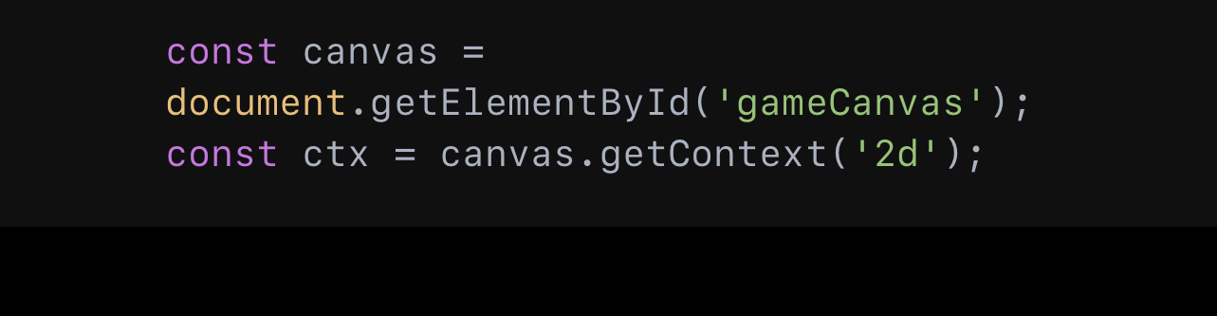
Initialize the Canvas in JavaScript
2. Create a game.js file and initialize the canvas

Slide 8
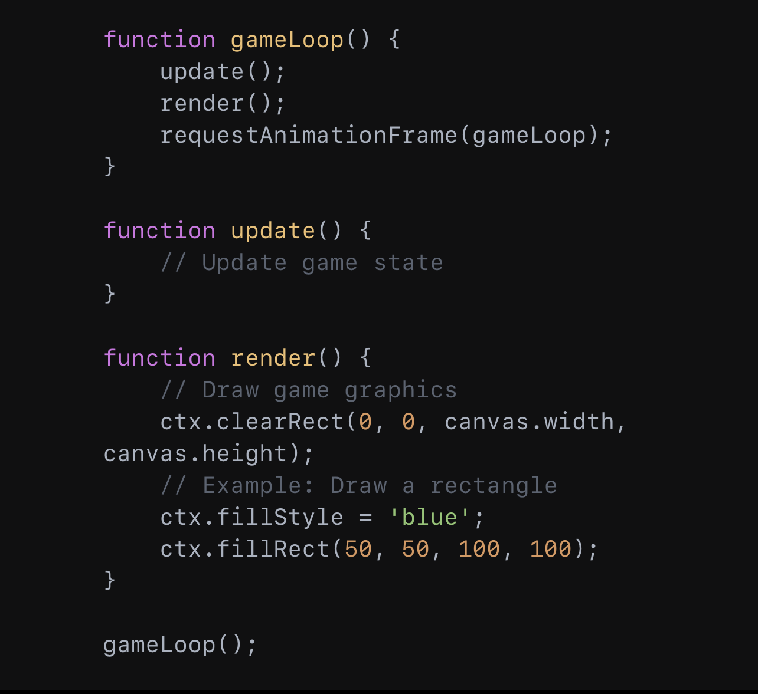
Game Loop
3. Create a game loop to update the game state and render the graphics

Slide 9
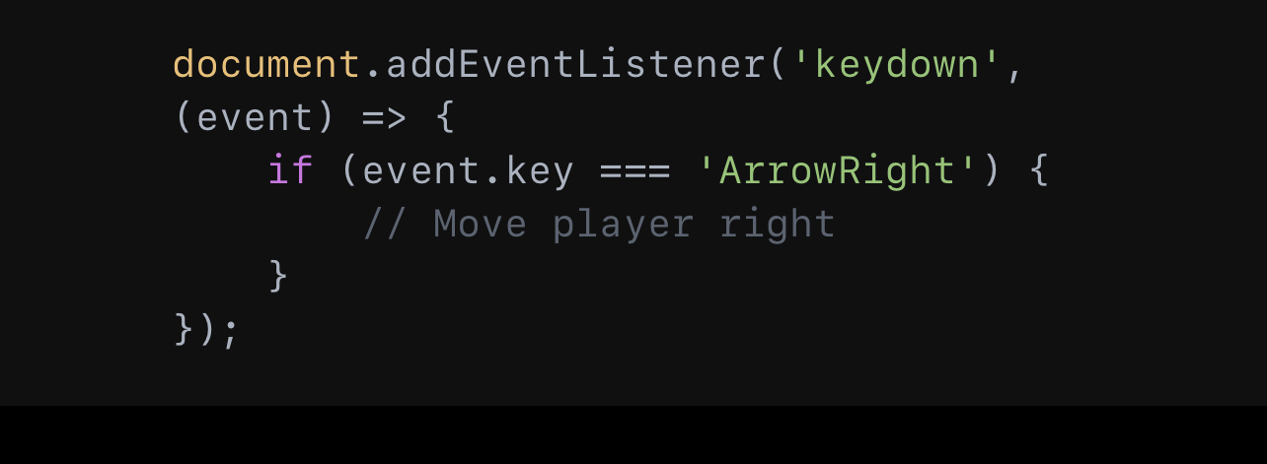
Handle User Input:
4. Add event listeners for keyboard or mouse inputs.

Slide 10
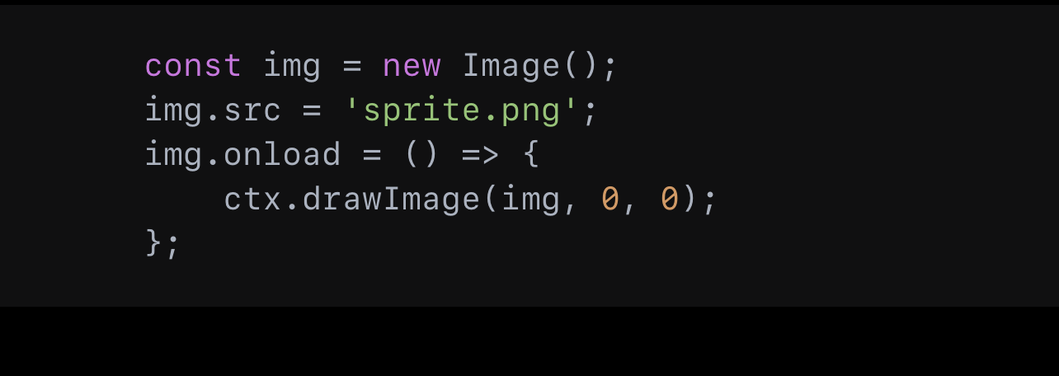
Adding Graphics
Sprites and Images

Slide 11
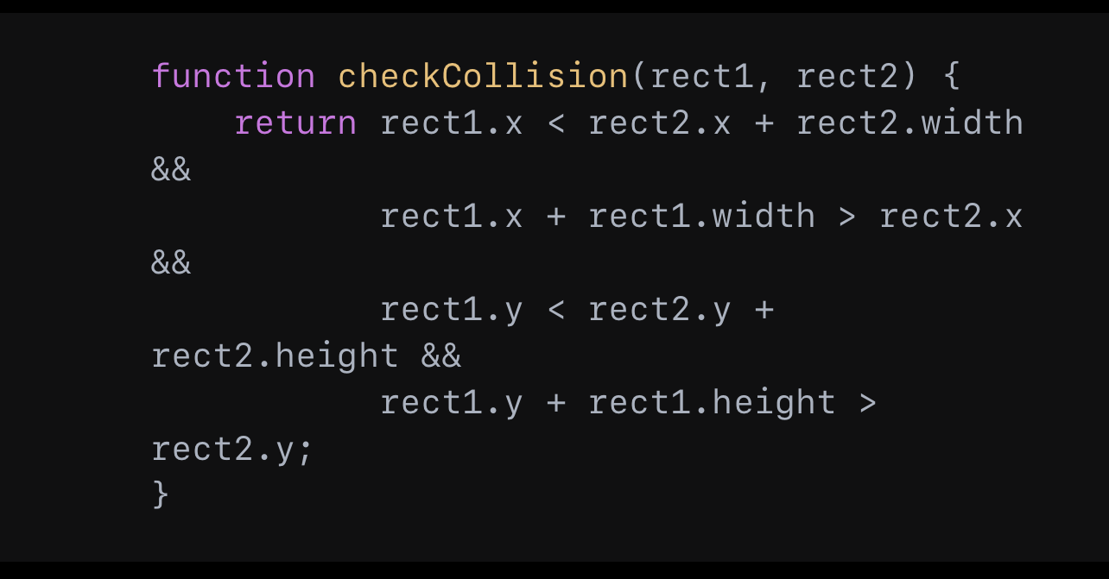
Advanced Topics:
Physics and collision Detection
Basic Collision Logic

Slide 12
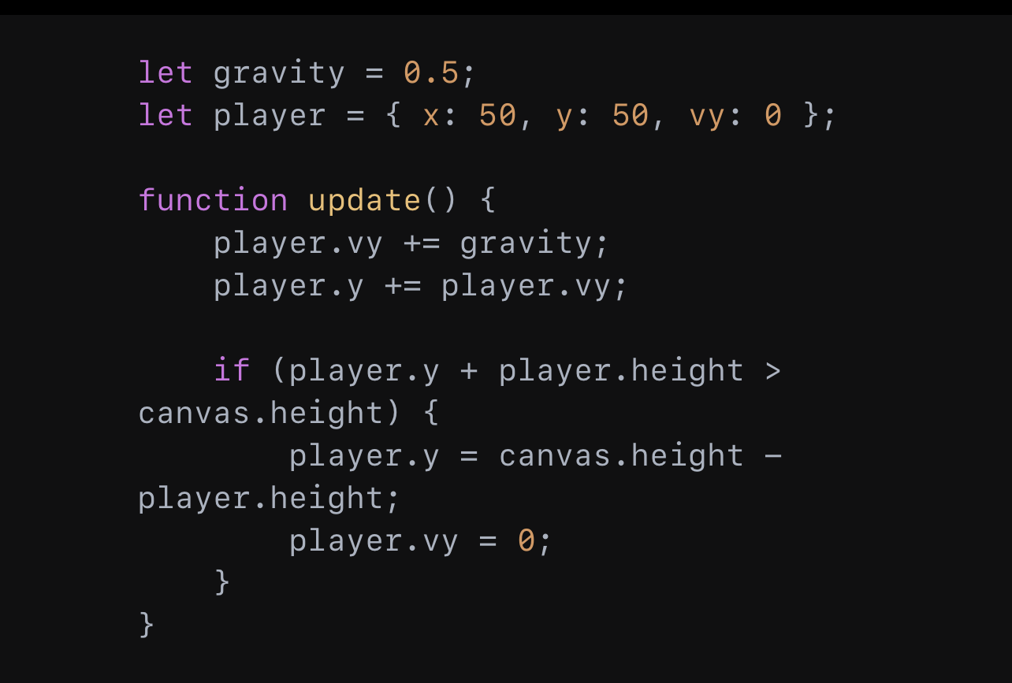
Advanced Topics
Gravity and Movement

Slide 13
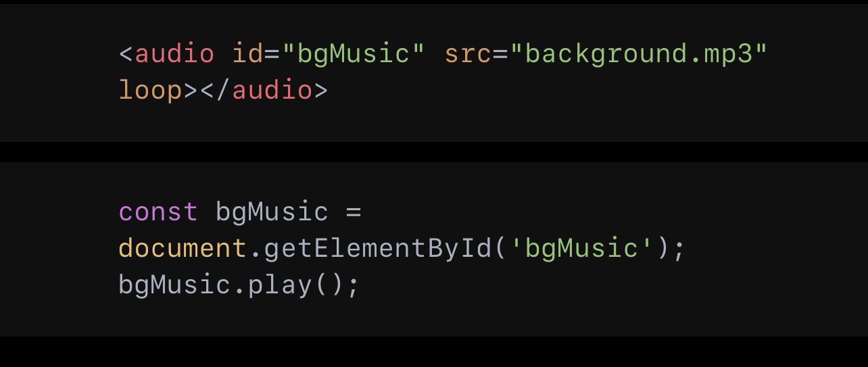
Advanced Topics: Sound and Music
Sound and Music: Adding Audio

Slide 14
Advanced Topics: Optimizing Performance
Optimizing Performance
Minimize DOM interactions
DOM: Document Object Model
Use requestAnimationFrame for smooth animations
Optimize Game Assets (images, audio)

Slide 15

Advance Topics: Using Game Frameworks
Using Game Frameworks: Popular Ones
Phaser
Three.js (for 3D Games)
Babylon.js
Benefits: Easier Development, build-in features, community support

Slide 16

Demo
Simple game developed using these concepts:
Snake.html
Click Link > Download (Top Right Corner) > Open Folder > Click Browser File and play game!

Slide 17

Resources
Documentation:
MDN Web Docs: HTML 5 Canvas
Phaser: Phraser Framework
Three.js: Three.js

Slide 18
Recap & Conclusions
For Game Design with HTML: What is the "The Trio" needed to create a fully functioning game?
HTML5 Canvas
CSS 3
JavaScript
Explain what each concept within "The Trio" does!
HTML5 Canvas: Structure and Canvas Element
CSS 3: Styling and Animations
JavaScript: Game Logic and Interactivity

Slide 19
Recap & Conclusions
3. What do you have to do to create a simple game?
Setup HTML Structure
Initialize the Canvas in JavaScript
Create a Game Loop
Handle User Input
4. How is user Input handled?
Keyboard Input
Mouse Input

Slide 20

Thank You & Questions

